Slide 1

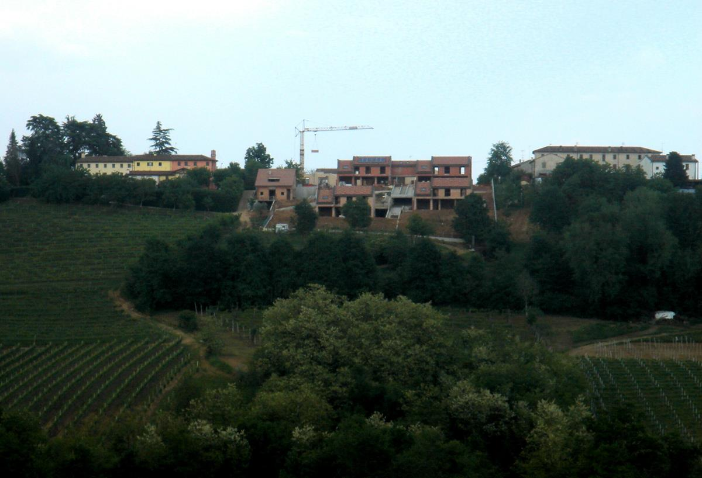
Horizon View Properties Project

Slide 2
Project Summary
It is the goal of Horizon View Properties to become the premier retirement housing community in the country for the more affluent segment of the baby-boomer retirees. A key to achieve that vision is to expand our reach beyond the Southern California area into other cities or towns in the country that would have a high potential for growth among our resident base.
Present recommendations to the Executive Team and the Board about geographical areas that they should consider for growing our presence over the next 5 years, by opening up new facilities in those locations.
Notes:
QuickStarter has created an outline to help you get started on your presentation. Some slides include information here in the notes to provide additional topics for you to research.

Slide 3
Strategy
Use Data Science tools and techniques to offer a data-driven perspective
Review data sources and choose those most suitable for the task
Use an iterative approach, share results and get feedback often

Slide 4
Objectives
Identify factors that contribute to or influence the desirability of an area for the target population (e.g. trends and shifts in demographics, quality of healthcare, weather, affordability, etc.)
Categorize all the different geographical regions into 5-10 groups with an easy-to-describe interpretation
Assign a “score” that quantifies the desirability or potential for each of these areas
Identify a few cities that are good candidates for the project

Slide 5
Data
City - City Name
State - State (2-letter abbreviation)
Recreation Score - Overall Rank from Best Cities for Recreation
Airport Passengers - Enplanements from List of Airports
Cost of Living - Cost of Living Plus Rent Index from Cost of Living
Weather Rank - Weather Rank from Best Cities for Recreation
State Health Rank - Overall Rank from Health Rank by State

Slide 6
Analysis
Simple Composite Score
Come up with one or two composite scores that can be used for city selection
Rank-filtered selection
Perform manual filtering on all dimensions based on expertise
Filters remove cities that have low ranks, leaving cities that have acceptable ranks
Cluster definition
Use cluster analysis to identify 4-5 clusters of cities based on our selected dimensions
Identify common themes

Slide 7
Simple Composite Score
The variables were all put on the same scale going from 1 to 56, with the higher the values being a positive interpretation of the variable. These are named Score or Rank.
Took the Recreation Score, Cost of Living Score, Weather Rank, and the Health Care Rank to come up a with a weighted average, which can be used as a desirability score that summarizes information from our variables.
Health Care Rank 50% Weight
Recreation Score 28% Weight
Weather Rank 20% Weight
Cost of Living Score 2% Weight

Slide 8
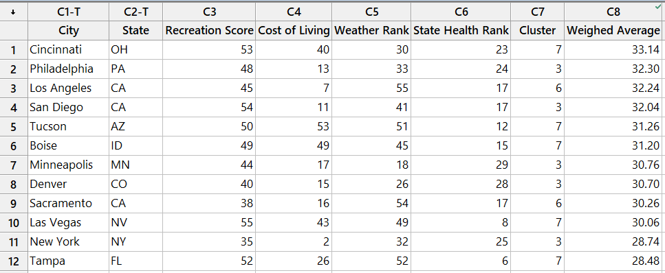
Simple Composite Score Results

Slide 9
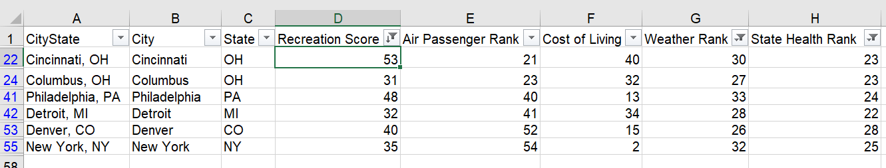
Rank-Filtered Results
Cities that are in the top 25 in all three of the following:
Recreation, Weather, Health
Cities are filtered by Recreation > 20, Weather > 20, State Health Rank > 20
Filters can be adjusted to allow lower scores and/or require higher scores in any dimension
Cities are sorted by Recreation Score (best to worst)
Sort can be modified to favor any of the other dimensions

Slide 10
Cluster Definition
A Cluster observation analysis was performed using the following variables
Recreation Score ,
Cost of Living Score
Weather Rank
State Health Rank
5 Clusters were created
Cluster 1 (11 cities) - Less desirable for recreation or weather, more desirable for Cost of Living and Health
Cluster 2 (16 cities) - Most Desirable for recreation and weather, cost of living is more desirable but less desirable for health (high priority)
Cluster 3 (11 cities) - Less desirable for all traits and not desirable for health
Cluster 4 (8 cities) - Most Desirable for weather, more desirable for Recreation less Desirable for health (high priority) and cost of Living
Cluster 5 (10 cities) - Most Desirable for Recreation and Health and less desirable for weather and cost of living
Cluster 5 is observed to be the best performing based on our target population, with high Recreation Score(high Priority) and high Health Rank (high Priority) ,medium to high Cost of Living Score, low to medium Weather Rank

Slide 11
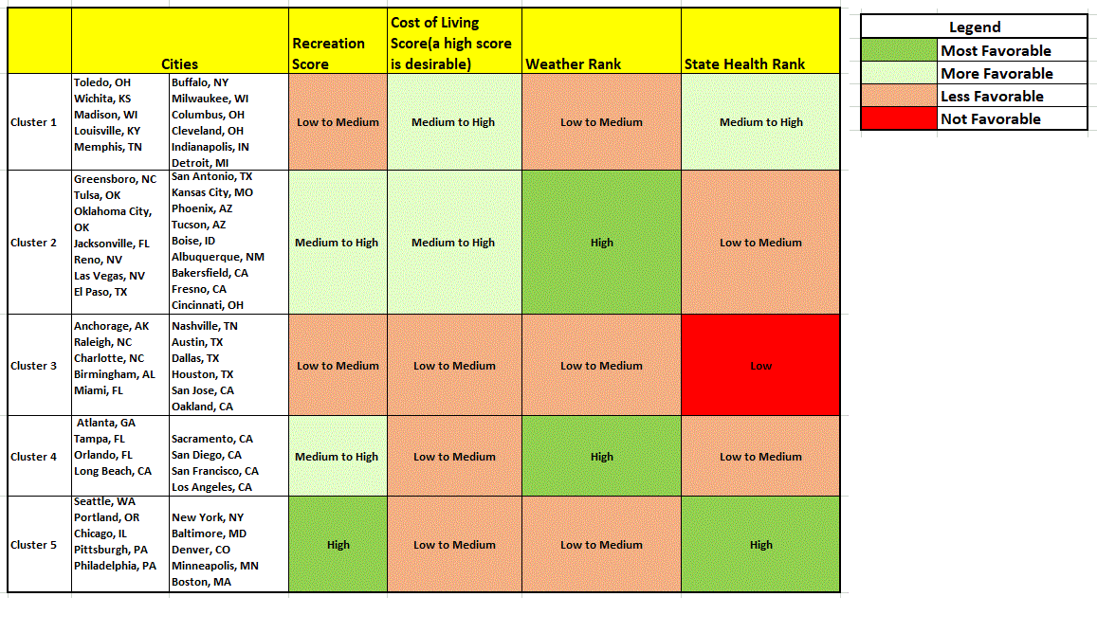

Slide 12
Recommendations
Based on the results of the three different analytical methods, these are the cities we recommend would be good candidates for growing the business.
New York
Denver
Philadelphia
Cincinnati

Slide 13
Next Steps
In order to make our analysis more robust, it is worth considering data pertaining to the following topics:
Housing Markets
Crime Rates
Strength/Existence of Potential Competitors
Socio Economic Scores
Age Demographics/Trends

Slide 14
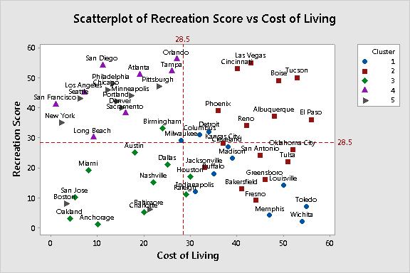
Appendix - Cluster Analysis Scatter Plots

Slide 15
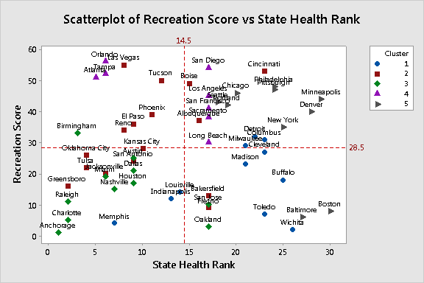
Appendix - Cluster Analysis Scatter Plots

Slide 16
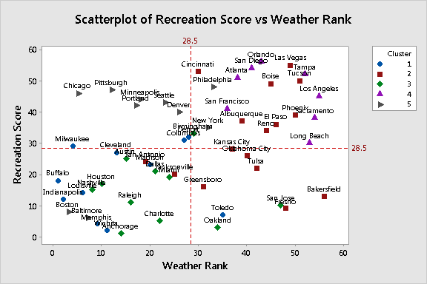
Appendix - Cluster Analysis Scatter Plots

Slide 17
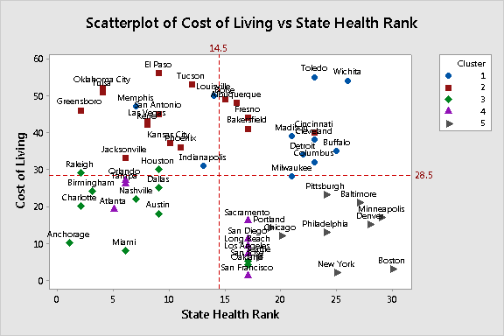
Appendix - Cluster Analysis Scatter Plots

Slide 18
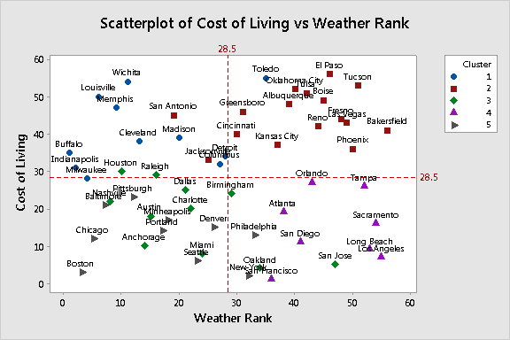
Appendix - Cluster Analysis Scatter Plots

Slide 19
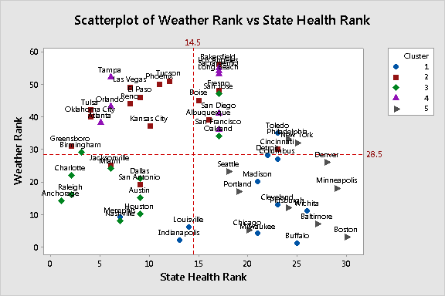
Appendix - Cluster Analysis Scatter Plots

Slide 20
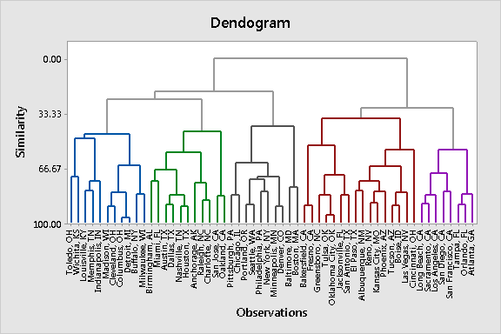
Appendix - Cluster Analysis Dendrogram

Slide 21
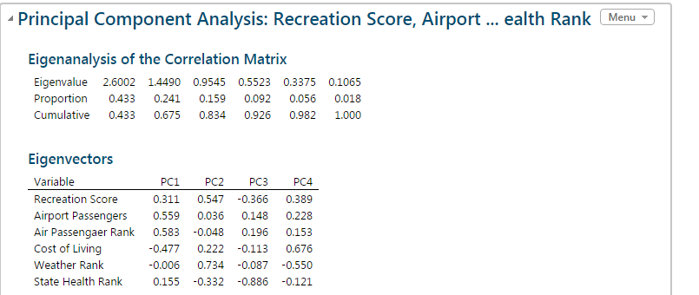
Appendix -Principal Component Analysis
Principal Component Analysis was also one of the methods used for data reduction
4 Principal Component scores were used to obtain the following Correlation Matrix and EigenVectors

Slide 22
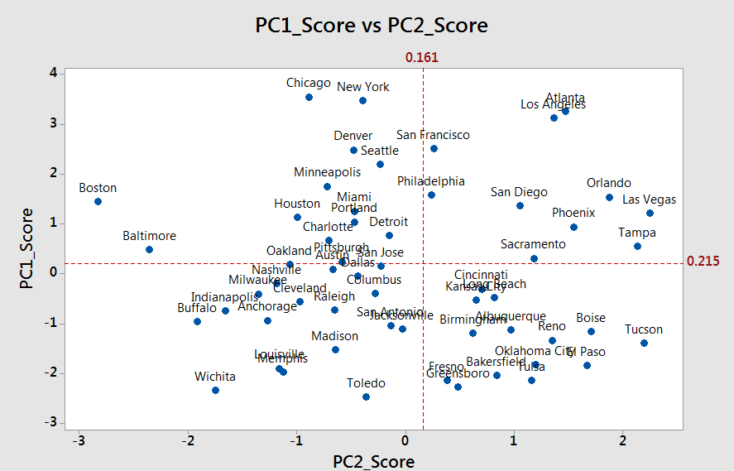
Appendix -Principal Component Analysis Scatter Plots

Slide 23
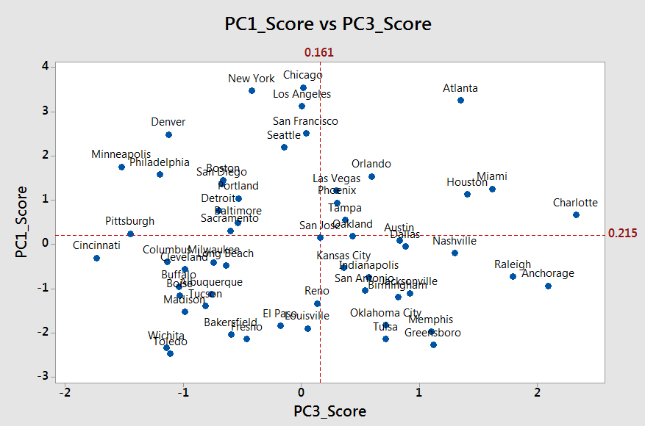
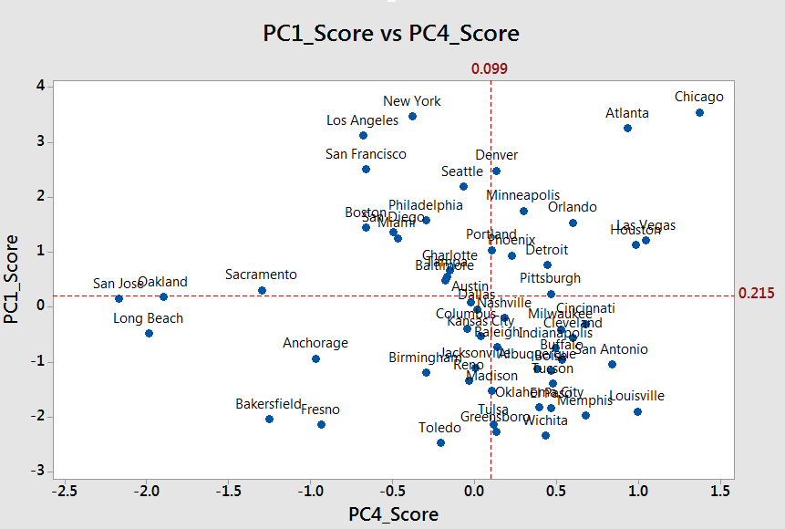
Appendix -Principal Component Analysis Scatter Plots

Slide 24
Sources
Best Cities for Recreation
Description: Ranked list of top 100 cities for recreation
Source: https://wallethub.com/edu/best-worst-cities-for-recreation/5144/ (WalletHub financial advice website)
Variables: Overall Rank, City, Total Score, Entertainment & Recreational Facilities Rank, Costs Rank, Quality of Parks Rank, Weather Rank
Health Rank by State
Description: Ranking of the 50 states by the quality of their health case
Source: https://wallethub.com/edu/states-with-best-health-care/23457/
Variables: State, Overall Rank, Cost Rank, Access Rank, Outcomes Rank, Total Score
List of Airports
Description: List of Airports throughout the US and
Source: https://en.wikipedia.org/wiki/List_of_airports_in_the_United_States
Variables: City, Airport, Role - Large hub, Medium hub, Small hub, No Hub, Enplanements (number of commercial passenger boardings that occurred at the airport in calendar year 2015 as per FAA records)
Cost of Living
Description: Ranking of the top US cities with the worst to best cost of living.
Source: https://www.numbeo.com/cost-of-living/
Variables: City, Cost of Living Index, Rent index, Cost of Living Plus Rent Index, Groceries Index, Restaurant Price Index, Local Purchasing Power Index

